Slide 1
WINLAB / BMW LAB
OAI Scheduler Allocation
vs. O-RU Power Consumption
How does downlink resource allocation change delivered throughput, Pegatron O-RU active power, and energy per delivered bit?
WINLAB / O-Cloud - single UE
Jesaya David G.N.P. | 5 August 2026
01
Notes:
Timing target: 0:30
- Open with the research question, then state that this week moved from proving custom scheduler behavior to measuring throughput and O-RU power across scheduler caps and offered loads.
- Keep the setup description to one sentence: WINLAB/O-Cloud, one Samsung UE, Pegatron O-RU, and Outlet 2 active power.
[Sources]
- docs/StudyNotes/2026-08-05_WINLAB_Weekly-Presentation_Plan.md
- Jesaya David_TEEP Introduction-2.pdf (visual reference)
[/Sources]

Slide 2
WEEKLY UPDATE
Experiment Flow Recap
BUILD / DEPLOYMENT
Git / OAI
source
Jenkins
Quay
Kubernetes VNF
OAI MAC scheduler
container image under test
RADIO / DATA
nFAPI P5/P7
RF
VNF
PNF worker
runtime
O-RAN FHI
7.2
Pegatron
O-RU
Samsung
UE
iPerf /
Open5GS
MEASUREMENT
rApp / artifacts
PDU Outlet 2
InfluxDB
Time merge
Plots
02
Notes:
Timing target: 1:15
- Walk left-to-right through build/deployment, then radio/data, then measurement.
- Emphasize the VNF/PNF boundary: the VNF contains the scheduler under test, while PNF uses a separate worker-mounted runtime.
- Close by pointing out that throughput and Outlet 2 power are aligned by timestamp before plotting.
[Sources]
- docs/StudyNotes/2026-08-05_WINLAB_Weekly-Presentation_Plan.md
- docs/StudyNotes/2026-08-05_WINLAB_OAI-Latest_Load-Sweep_Power-Curve_and_Run-QC.md
[/Sources]

Slide 3
WEEKLY UPDATE
Checklist
DONE
Restored Jenkins and Quay, built 54- and 104-PRB images.
Final checklist
Tracks reproducibility, VNF/PNF identities, baseline coverage, comparisons, uncertainty, model, dataset, report, and deck.
DONE
Validated with scheduler telemetry & throughput data
DONE
Completed the 900 Mbps 27-/54-/104-PRB and OAI latest comparison.
DONE
Power-aligned the OAI latest curve through 600 Mbps.
Open final checklist
NEXT
Complete 700-900 Mbps, finish incomplete runs, and modify & test OAI scheduler burst-types
03
Notes:
Timing target: 1:10
- Read only the transition: four engineering milestones are complete; the remaining work is scientific repetition and uncertainty.
- Open the checklist only if asked. Explain that it prevents completed engineering validation from being confused with a validated causal claim.
[Sources]
- docs/WINLAB-Final-Checklist.md
- https://github.com/bmw-ntust-internship/internship/blob/2026-TEEP-2-JDavid/docs/WINLAB-Final-Checklist.md
- docs/StudyNotes/2026-08-05_WINLAB_Weekly-Presentation_Plan.md
[/Sources]

Slide 4
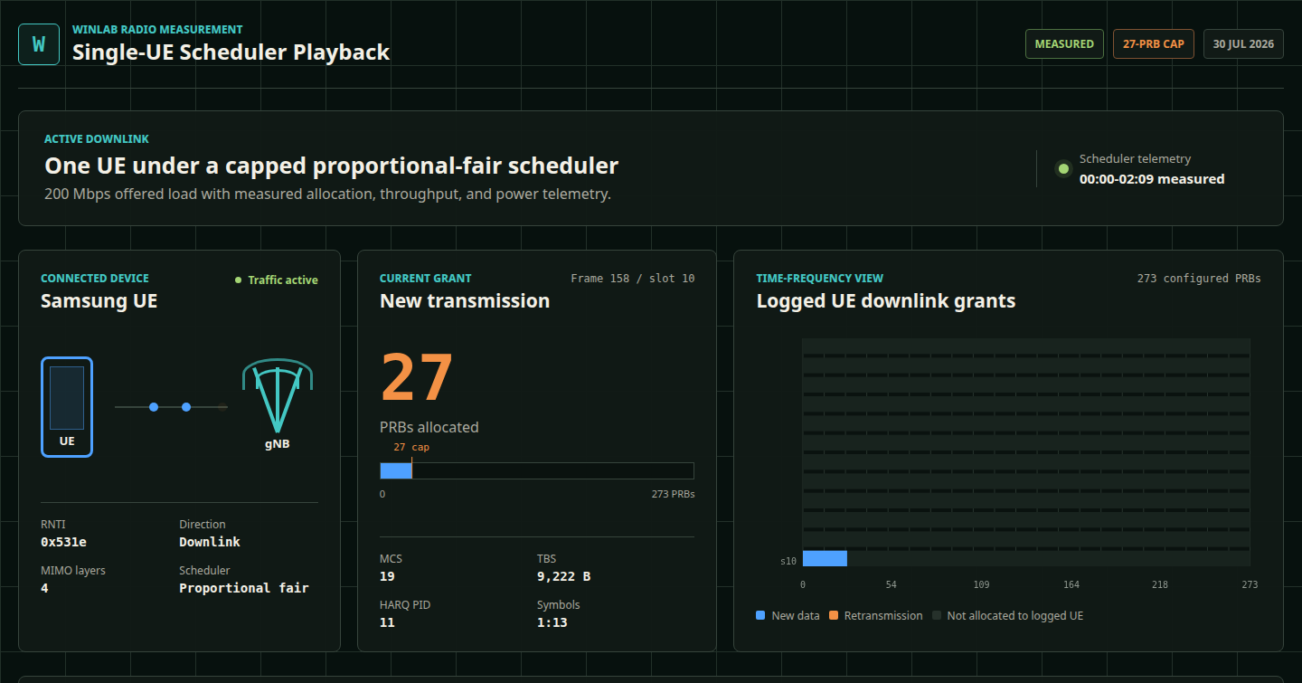
WEEKLY UPDATE
Measured scheduler behavior
OFFLINE PLAYBACK
UE and connected-device identity
New transmission vs. HARQ retransmission
Allocated PRB start and size
MCS, TBS, and HARQ process
Measured scheduler logs -> replayable evidence
The custom images enforced the intended new-data PRB cap.
04
Notes:
Timing target: 0:45
- State clearly that this is an offline playback of measured scheduler telemetry, not a live monitoring dashboard.
- Use one representative frame to point out identity, grant type, PRB allocation, and MCS/TBS/HARQ state.
- The optional live demo should be 20-30 seconds only and is not required for the evidence to remain in the deck.
[Sources]
- assets/winlab_scheduler_playback/qa-desktop.png
- https://github.com/bmw-ntust-internship/internship/blob/2026-TEEP-2-JDavid/assets/winlab_scheduler_playback/index.html
- https://github.com/bmw-ntust-internship/internship/blob/2026-TEEP-2-JDavid/assets/winlab_scheduler_playback/README.md
[/Sources]

Slide 5
WEEKLY UPDATE
(PRB Cap) Throughput 8x & power + ~1 W
Throughput
95.6 -> 760.7 Mbps (~8x)
Mean O-RU power
40.95 -> 41.99 W (+1.04 W)
Energy / delivered bit
428.36 -> 55.20 nJ/bit
Note: Sequential single runs from the same image base with modified cap parameters.
05
Notes:
Timing target: 1:30
- Lead with the contrast: delivered throughput changed by about eight times while mean O-RU power changed by only about one watt.
- Mention energy per delivered bit only as a consequence of the large load-independent component being amortized over more delivered traffic.
- End with the scientific boundary: different image lineages, sequential single runs, no confidence intervals or causal claim.
[Sources]
- docs/StudyNotes/2026-08-04_WINLAB_900Mbps_PRB-Cap_Sweep_and_Debug-UI_Assessment.md
- https://github.com/bmw-ntust-internship/internship/blob/2026-TEEP-2-JDavid/docs/StudyNotes/2026-08-04_WINLAB_900Mbps_PRB-Cap_Sweep_and_Debug-UI_Assessment.md
[/Sources]

Slide 6
WEEKLY UPDATE
(Bandwidth) Power + 1.42 W & Throughput 5x
Findings
Delivered throughput: 100 to 495 Mbps across complete runs.
Mean active power: 40.59 to 42.02 W (+1.42 W).
The 300 and 600 Mbps attempts were incomplete diagnostics.
Teal = complete baseline • Orange = incomplete diagnostic • Regression uses complete runs only
06
Notes:
Timing target: 1:20
- This is the direct throughput-versus-power view requested in the study plan: x is delivered throughput and y is run-mean PDU Outlet 2 active power.
- Across the four complete baseline runs, delivered throughput increases from about 100 to 495 Mbps while mean active power increases from 40.594 to 42.015 W.
- The line is a descriptive fit to complete runs only: P(W) = 40.2752 + 0.0032028 × throughput(Mbps), R² = 0.9246, n = 4.
- Orange points are incomplete diagnostic runs; do not treat them as equivalent evidence or claim causality from this small unreplicated sample.
[Sources]
- runs/analysis/20260805_oai_latest_baseline_100_600/load_sweep_summary.csv
- docs/StudyNotes/2026-08-05_WINLAB_OAI-Latest_Load-Sweep_Power-Curve_and_Run-QC.md
- docs/StudyNotes/2026-08-05_WINLAB_Weekly-Presentation_Plan.md
[/Sources]

Slide 7
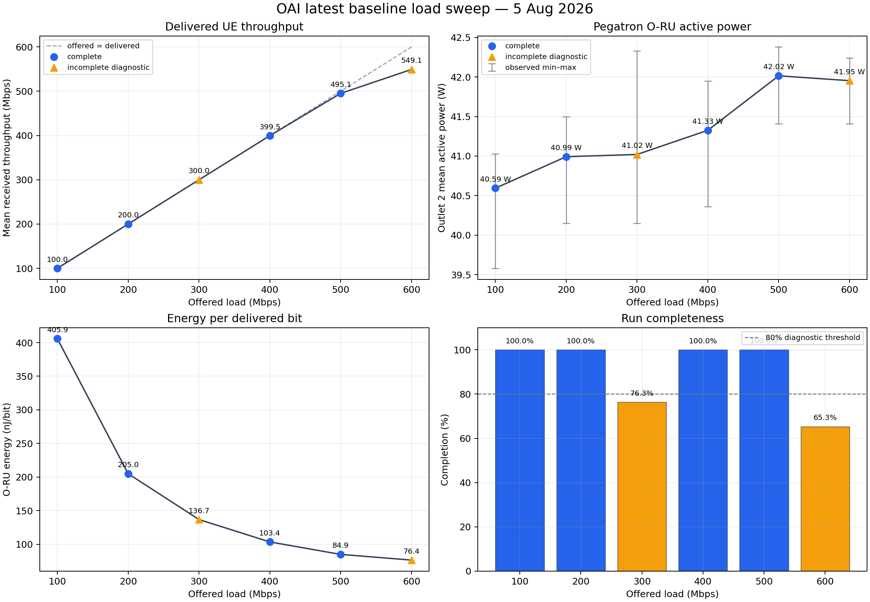
WEEKLY UPDATE
Power Graphs
THREE OBSERVATIONS
Delivered throughput tracks offered load through about 400 Mbps.
Saturation appears around 500-600 Mbps.
Mean active power rises only from about 40.6 to 42.0 W.
P(W) = 40.2752 +
0.0032028 x throughput
R^2 = 0.9246 | n = 4
Orange points are because 300 and 600 Mbps are incomplete diagnostics.
07
Notes:
Timing target: 1:35
- Explain only the three observations shown at right; do not narrate every point.
- Point out that orange means incomplete diagnostic, not equivalent evidence.
- Qualify the fit immediately: four complete points, one run each, no randomization or statistical uncertainty yet.
[Sources]
- runs/analysis/20260805_oai_latest_baseline_100_600/load_sweep_overview.png
- runs/analysis/20260805_oai_latest_baseline_100_600/load_sweep_summary.csv
- https://github.com/bmw-ntust-internship/internship/blob/2026-TEEP-2-JDavid/docs/StudyNotes/2026-08-05_WINLAB_OAI-Latest_Load-Sweep_Power-Curve_and_Run-QC.md
[/Sources]

Slide 8
WEEKLY UPDATE
Found Issues and Possible Causes
OBSERVED
INTERPRETATION
Automation sometimes stalled between offered-load steps.
Consistent with backpressure and timing instability
VNF logs reported SDU buffer full and RRC re-establishment: Other Failure. (during 2 runs)
Issues don’t come from one root cause
The VNF / radio path stopped progressing in some higher-load attempts.
The failure cannot be attributed only to the custom scheduler.
The 600 Mbps retry delivered 549.112 Mbps at 65.333% completion.
The image used isn’t the cause of the issues (w28)
VNF is 13 commits newer than OAI 2026.w28 + UE repeatedly reported RI 2 (effective rank two)
08
Notes:
Timing target: 1:20
- Separate observation from interpretation explicitly.
- The evidence supports a backpressure/timing hypothesis but does not isolate a single root cause.
- Use the version and RI evidence only to bound interpretation: the VNF is newer than the requested tag and the measured UE link was effectively rank two.
[Sources]
- docs/StudyNotes/2026-08-05_WINLAB_OAI-Latest_Load-Sweep_Power-Curve_and_Run-QC.md
- https://github.com/bmw-ntust-internship/internship/blob/2026-TEEP-2-JDavid/docs/StudyNotes/2026-08-05_WINLAB_OAI-Latest_Load-Sweep_Power-Curve_and_Run-QC.md
[/Sources]

Slide 9
WEEKLY UPDATE
Next Target: Scheduling Shape
Narrow Spread
Wide Burst
Each slot gets a fixed PRB quota (e.g. 27 PRB)
One slot gets a large continuous grant
Give smaller new-data grants for many slots
Then the other slots are given less / zero (gated)
Both has similar targets for delivered data
Control
One OAI base, but using selectable modes
Modify phase-3 new-data scheduling (nr_dl_proportional_fair())
Keep HARQ etc. unchanged, add logging
09
Notes:
Timing target: 1:20
- Separate observation from interpretation explicitly.
- The evidence supports a backpressure/timing hypothesis but does not isolate a single root cause.
- Use the version and RI evidence only to bound interpretation: the VNF is newer than the requested tag and the measured UE link was effectively rank two.
[Sources]
- docs/StudyNotes/2026-08-05_WINLAB_OAI-Latest_Load-Sweep_Power-Curve_and_Run-QC.md
- https://github.com/bmw-ntust-internship/internship/blob/2026-TEEP-2-JDavid/docs/StudyNotes/2026-08-05_WINLAB_OAI-Latest_Load-Sweep_Power-Curve_and_Run-QC.md
[/Sources]

Slide 10
WEEKLY UPDATE
Plans
PLAN
EXPECTED FINAL GOALS
1
Complete the baseline
Reproducible throughput vs power model
Run 700, 800, and 900 Mbps individually
Baseline vs custom scheduler comparison
2
Validate the model
Mean + variance, uncertainty ranges, separate saturation.
Throughput, power, and energy/bit data
3
Deeper scheduler experiment
Final checklist, dataset, plots, methodology, report
One current OAI base, runtime-selectable baseline / custom modes.
There’s a large load-independent O-RU power component. I will also test whether scheduler behavior changes power beyond normal run-to-run variation.
10
Notes:
Timing target: 1:10
- Describe the next work as a sequence: finish coverage, quantify uncertainty, then compare scheduler modes on one common source base.
- Close on the bounded inference about a large load-independent component and the question that repeated trials must answer.
- Use the final sentence to hand off to the next presenter.
[Sources]
- docs/StudyNotes/2026-08-05_WINLAB_Weekly-Presentation_Plan.md
- docs/WINLAB-Final-Checklist.md
[/Sources]

Slide 11
WEEKLY UPDATE
Thank You!
10
Notes:
Timing target: 1:10
- Describe the next work as a sequence: finish coverage, quantify uncertainty, then compare scheduler modes on one common source base.
- Close on the bounded inference about a large load-independent component and the question that repeated trials must answer.
- Use the final sentence to hand off to the next presenter.
[Sources]
- docs/StudyNotes/2026-08-05_WINLAB_Weekly-Presentation_Plan.md
- docs/WINLAB-Final-Checklist.md
[/Sources]

Slide 12
BACKUP
VNF and PNF are separate runtimes
KUBERNETES VNF
PNF WORKER RUNTIME
Contains
nFAPI P5/P7
Executes
OAI MAC scheduler under test
Worker-mounted OAI / FHI / DPDK
Digest-pinned container image
Separate commit and local repairs
VNF configuration and pod logs
RU / P7 behavior and worker logs
A VNF rollout changes the scheduler but leaves the PNF runtime untouched.
BACKUP - NOT IN TIMED FLOW
11
Notes:
Timing target: Backup
- Use this slide when asked why changing or rolling back the VNF did not necessarily repair the radio-side runtime.
[Sources]
- docs/StudyNotes/2026-08-05_WINLAB_OAI-Latest_Load-Sweep_Power-Curve_and_Run-QC.md
[/Sources]

Slide 13
BACKUP
Constants
Constants
Variables
Samsung UE and target cell
VNF condition: 27 / 54 / 104 PRB or OAI latest
Pegatron O-RU and PDU Outlet 2
VNF image lineage differs
PNF runtime, core, and namespace
Sequential run order and lab time
900 Mbps downlink offered load
Timestamp-alignment method
One run per condition, no confidence intervals
Run completion: 27 PRB 93.25% | 54 PRB 82.00% | 104 PRB 93.08% | OAI latest 93.00%
BACKUP - NT IN TIMED FLOW
12
Notes:
Timing target: Backup
- Exact audit metadata is intentionally kept out of the visible slide.
- 27 PRB image digest: sha256:409690de1803d3705b3419f4a35cbe65e36efa1af2f832d5977b6db5fff9eadd; artifact e2e-ocloud-20260804-061813.
- 54 PRB image digest: sha256:307d0e269a4187df719e0d48928ce639c8084f843411bdebb121fd3b9ee983ea; artifact e2e-ocloud-20260804-065538.
- 104 PRB image digest: sha256:1f1ffe2736e8e0ce91e90db586348d3bc8d42cbe669019a4154b8af58e239a8a; artifact e2e-ocloud-20260804-071951.
- OAI latest image digest: sha256:c227006518795bdb517db0db15be7c12850c9184297e4cb514ea3987a5108edc; artifact e2e-ocloud-20260804-040735.
[Sources]
- docs/StudyNotes/2026-08-04_WINLAB_900Mbps_PRB-Cap_Sweep_and_Debug-UI_Assessment.md
- https://github.com/bmw-ntust-internship/internship/blob/2026-TEEP-2-JDavid/docs/StudyNotes/2026-08-04_WINLAB_900Mbps_PRB-Cap_Sweep_and_Debug-UI_Assessment.md
[/Sources]

Slide 14
BACKUP
Run Completeness
Complete points
100, 200, 400, and 500 Mbps enter the initial fit.
Diagnostic only
300 and 600 Mbps are not complete, so they aren’t equal in credibility
BACKUP - NOT IN TIMED FLOW
13
Notes:
Timing target: Backup
- Completeness is positive-traffic window span divided by the requested 600 seconds.
[Sources]
- runs/analysis/20260805_oai_latest_baseline_100_600/load_sweep_summary.csv
- https://github.com/bmw-ntust-internship/internship/blob/2026-TEEP-2-JDavid/docs/StudyNotes/2026-08-05_WINLAB_OAI-Latest_Load-Sweep_Power-Curve_and_Run-QC.md
[/Sources]

Slide 15
BACKUP
Failure Chronology
Traffic flattens
Buffer pressure
Radio path stalls
RRC recovery
Run stopped
1
2
3
4
5
High-load iPerf stops progressing.
SDU rejected: buffer full appears.
VNF / split path ceases forward progress.
Re-establishment requests: Other Failure.
Evidence preserved; next load run individually.
Consistent with backpressure and timing instability
BACKUP - NOT IN TIMED FLOW
14
Notes:
Timing target: Backup
- Cumulative pod logs can repeat earlier events, so future runs need per-step log markers before counting event frequency.
[Sources]
- https://github.com/bmw-ntust-internship/internship/blob/2026-TEEP-2-JDavid/docs/StudyNotes/2026-08-05_WINLAB_OAI-Latest_Load-Sweep_Power-Curve_and_Run-QC.md
[/Sources]

Slide 16
BACKUP
Merge power inside positive-traffic windows
1
2
3
4
5
Request
Traffic window
PDU export
Merge
Report
Record offered load and requested duration.
Use finalized iPerf timestamps with positive throughput.
Clip Outlet 2 active_power to the same UTC window.
Join throughput and power on one clock.
Throughput, power, completion, and energy/bit together.
Quality rule
Incomplete runs stay visible and classified.
BACKUP - NOT IN TIMED FLOW
15
Notes:
Timing target: Backup
- The established merge procedure uses only the positive-traffic interval and reports sample count and completeness for each condition.
[Sources]
- https://github.com/bmw-ntust-internship/internship/blob/2026-TEEP-2-JDavid/docs/StudyNotes/2026-08-05_WINLAB_OAI-Latest_Load-Sweep_Power-Curve_and_Run-QC.md
- runs/analysis/20260805_oai_latest_baseline_100_600/load_sweep_summary.csv
[/Sources]

Slide 17
BACKUP
The checklist makes remaining work explicit
COMPLETED FOUNDATION
SCIENTIFIC WORK REMAINING
Environment and run artifacts preserved
Complete 700-900 Mbps
VNF and PNF identities recorded
Repeat loads and quantify variance
Custom PRB caps validated with telemetry
Common-source runtime-selectable modes
Initial baseline plot and descriptive fit
Final model, dataset, report, and deck QA
Open the maintained checklist
BACKUP - NOT IN TIMED FLOW
16
Notes:
Timing target: Backup
- The checklist is designed to survive weekly updates and become the final presentation/report completion gate.
[Sources]
- docs/WINLAB-Final-Checklist.md
- https://github.com/bmw-ntust-internship/internship/blob/2026-TEEP-2-JDavid/docs/WINLAB-Final-Checklist.md
[/Sources]

Slide 18
BACKUP
Telemetry to Validate Caps
UE / RNTI
Identifies the connected device and the grants attributed to it.
Grant type
Separates new transmissions from HARQ retransmissions.
PRB start / size
Shows where the grant begins and how many PRBs it allocates.
MCS and TBS
Captures coding/modulation and transport block size for the grant.
HARQ PID / round
Links retransmission state to the corresponding HARQ process.
Validation rule: do not infer a scheduler cap from iPerf throughput alone.
BACKUP - NOT IN TIMED FLOW
17
Notes:
Timing target: Backup
- Use this slide to answer what the playback proves and which logged fields support that conclusion.
[Sources]
- assets/winlab_scheduler_playback/README.md
- https://github.com/bmw-ntust-internship/internship/blob/2026-TEEP-2-JDavid/assets/winlab_scheduler_playback/index.html
- https://github.com/bmw-ntust-internship/internship/blob/2026-TEEP-2-JDavid/docs/StudyNotes/2026-08-04_WINLAB_900Mbps_PRB-Cap_Sweep_and_Debug-UI_Assessment.md
[/Sources]

